Slide 1
TRANSACTION

Slide 2
What is a transaction???
A transaction is a logical unit of work of database processing that includes one or more database access operations.
A transaction can be defined as an action or series of actions that is carried out by a single user or application program to perform operations for accessing the contents of the database.
The operations can include retrieval(Read), insertion (Write), deletion and modification.
A transaction must be either completed or aborted.

Slide 3
Different operations performed in a transaction
Operations | Descriptions
Read(x) | Read operation is used to read the value of X from the database and stores it in a buffer in main memory.
Write(X) | Write operation is used to write the value back to the database from the buffer.
Commit | It is used to save the work done permanently.
Rollback | It is used to undo the work done.

Slide 4
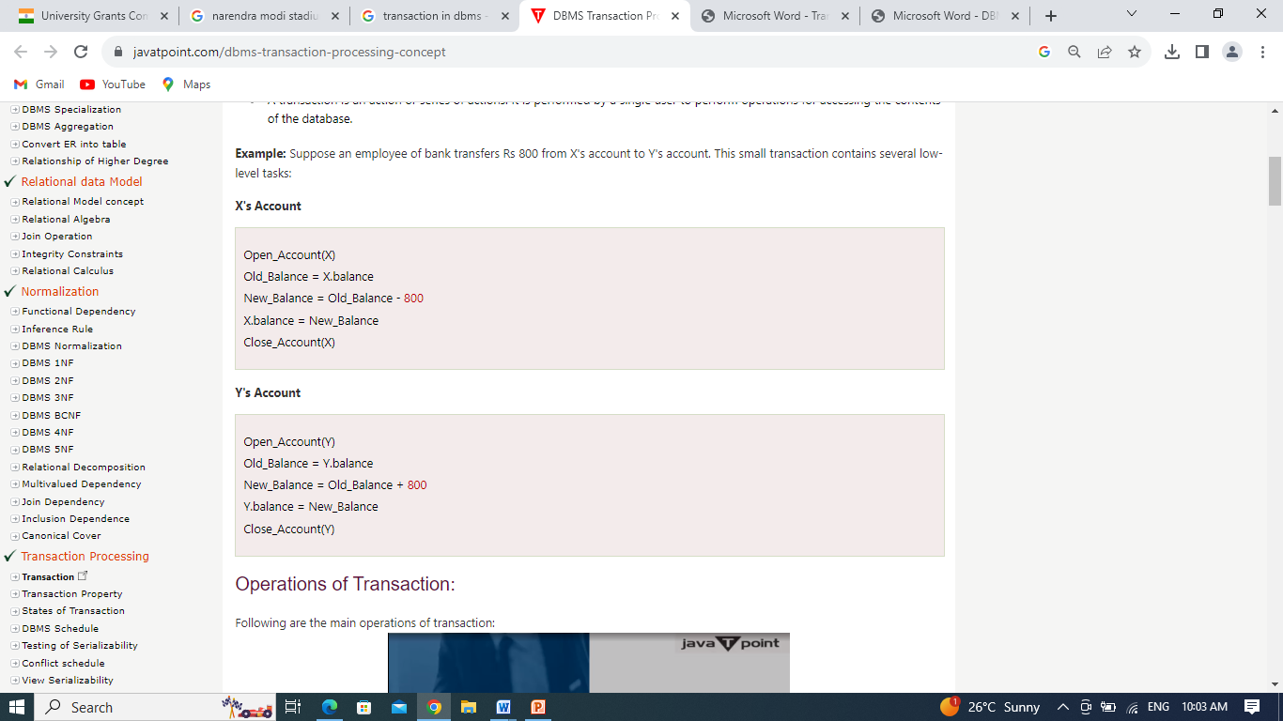
Example of a transaction

Slide 5
Properties of Transaction
A transaction is having four properties. Such as-
Atomicity
Consistency
Isolation
Durability

Slide 6
Atomicity
Atomicity means all successful or none.
It states that all operations of the transaction take place at once if not, the transaction is aborted.
There is no midway, i.e., the transaction cannot occur partially. Each transaction is treated as one unit and either run to completion or is not executed at all.

Slide 7
Atomicity
Atomicity involves the following two operations.
Abort: If a transaction aborts then all the changes made are not visible.
Commit: If a transaction commits then all the changes made are visible.

Slide 8
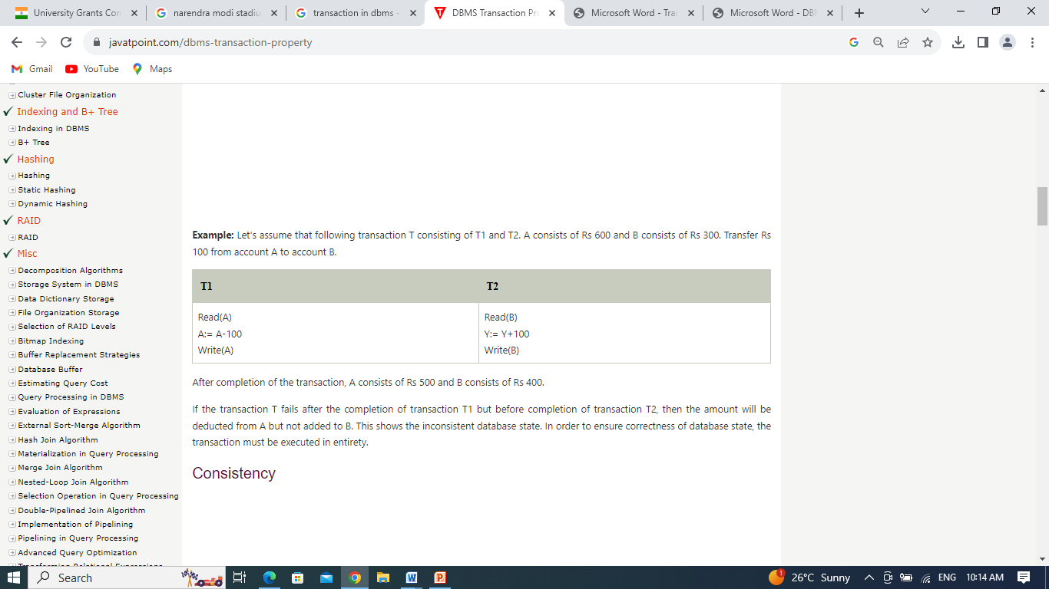
Example of Atomicity

Slide 9
Consistency
The integrity constraints are maintained so that the database is consistent before and after the transaction.
The execution of a transaction will leave a database in either its prior stable state or a new stable state.
The consistent property of database states that every transaction sees a consistent database instance.
The transaction is used to transform the database from one consistent state to another consistent state.

Slide 10
Consistency
In the previous example, the total balance of A and B should be same before and after T occurs.
Total before T occurs = 600+300=900
Total after T occurs= 500+400=900
Therefore, the database is consistent. In the case when T1 is completed but T2 fails, then inconsistency will occur.

Slide 11
Isolation
It shows that the data which is used at the time of execution of a transaction cannot be used by the second transaction until the first one is completed.
In isolation, if the transaction T1 is being executed and using the data item X, then that data item can't be accessed by any other transaction T2 until the transaction T1 ends.
The concurrency control subsystem of the DBMS enforced the isolation property.

Slide 12
Isolation
Although multiple transactions may execute concurrently, each transaction must be unaware of other concurrently executing transactions; intermediate transaction results must be hidden from other concurrently executed transactions.
No transaction will affect the existence of any other transaction.

Slide 13
Durability
The database should be durable enough to hold all its latest updates even if the system fails or restarts.
If a transaction updates a chunk of data in a database and commits, then the database will hold the modified data.
If a transaction commits but the system fails before the data could be written on to the disk, then that data will be updated once the system springs back into action.

Slide 14
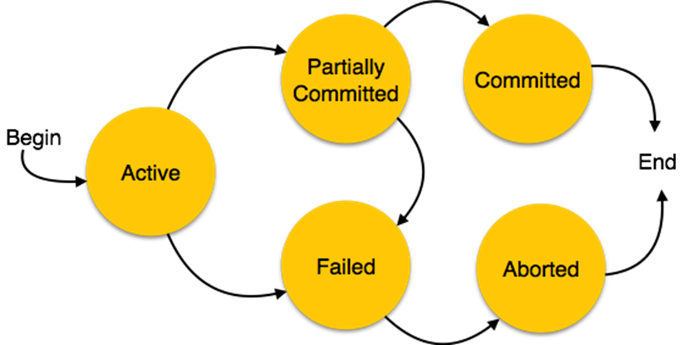
States of Transaction

Slide 15
States of Transaction
Active State:In this state, the transaction is being executed. This is the initial state of every transaction.
Partially Committed − When a transaction executes its final operation, but the data is not saved in disk, it is said to be in a partially committed state.
Failed − A transaction is said to be in a failed state if any of the checks made by the database recovery system fails. A failed transaction can no longer proceed further.

Slide 16
States of Transaction
Aborted − If any of the checks fails and the transaction has reached a failed state, then the recovery manager rolls back all its write operations on the database to bring the database back to its original state where it was prior to the execution of the transaction. Transactions in this state are called aborted. The database recovery module can select one of the two operations after a transaction aborts −
  Re-start the transaction
  Kill the transaction
Committed − If a transaction executes all its operations successfully, it is said to be committed. All its effects are now permanently established on the database system.

Slide 17
Thank You

